Slide 1
URBAN EATS

Slide 2
Topics
Abstract
Language and Software used
Explanation of Project
Advantage and Disadvantage
Conclusion

Slide 3
Explore a variety of delicious foods at URBAN EATS, your go-to online shop for gourmet meals and everyday eats. Discover fresh ingredients and tasty dishes catered to every taste bud. Enjoy easy ordering and fast delivery for a delightful dining experience at home.
ABSTRACT

Slide 4

LANGUAGE & SOFTWARE
HTML
CSS
JAVASCRIPT
REACT
VS CODE

Slide 5
This is my Navbar it have logo , Sections, cart icon and sign in button by using onclick event used for sign in button and sections when we click the section it navigate to the particular section and also I used hooks for onclick event ,when the section is clicked it will change the state to updated state. I decorated navbar by using CSS with flex and justify-content ;space-between
Explanation of Project
.

Slide 6
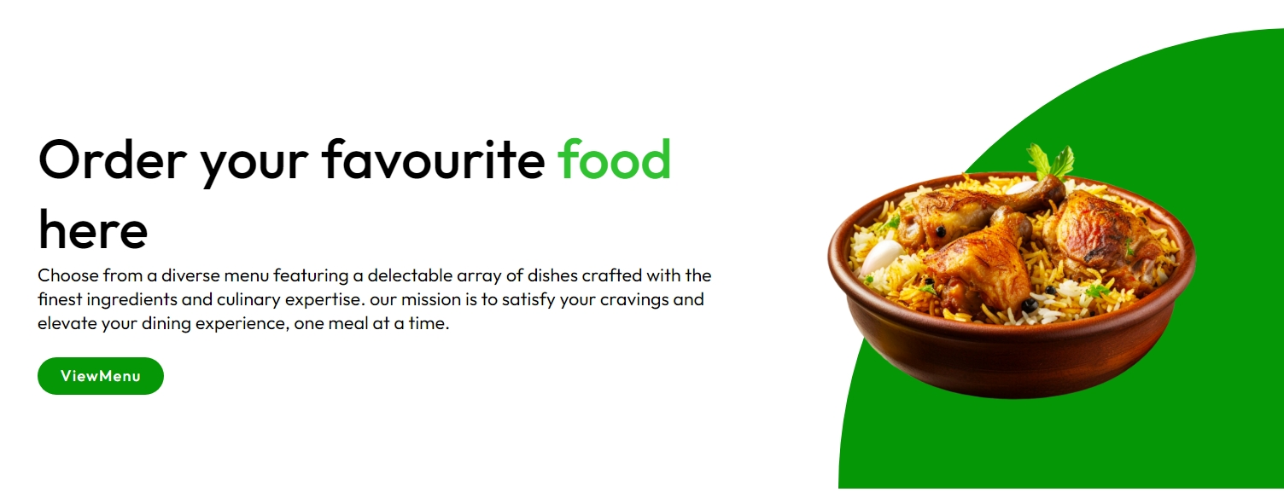
This is my header section it have heading,paragraph,button,image and quarter circle. The header image used from assets file by import and the quarter circle was done by CSS using border radius

Slide 7
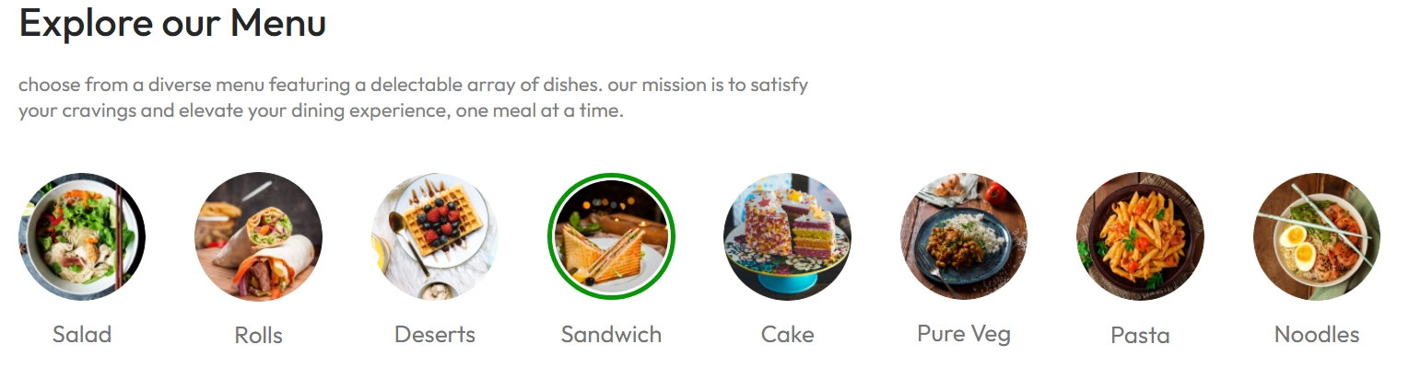
This is Explore Section it have food categories with image and text .
I import images from assets folder and using map function I get all images from assests and also onclick event is used. When the type of food is clicked it will show the green border and it will display only particular foods .

Slide 8
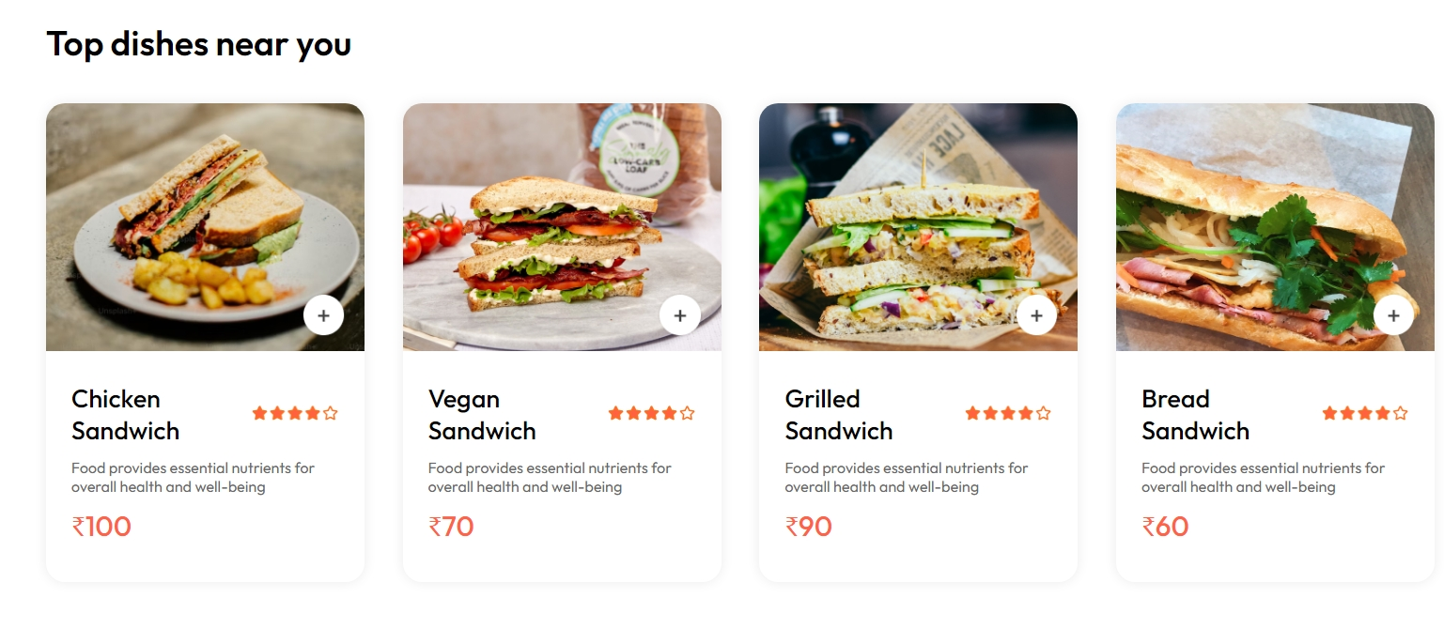
This is Food Display Section it have All food images, ratings and add icons, In food display if you want particular food means you should click on above explore Menu section it will filter and shows the Certain food and images get from assests folder .By using map function food products are displayed and also if you click the add button the food items added on cart

Slide 9
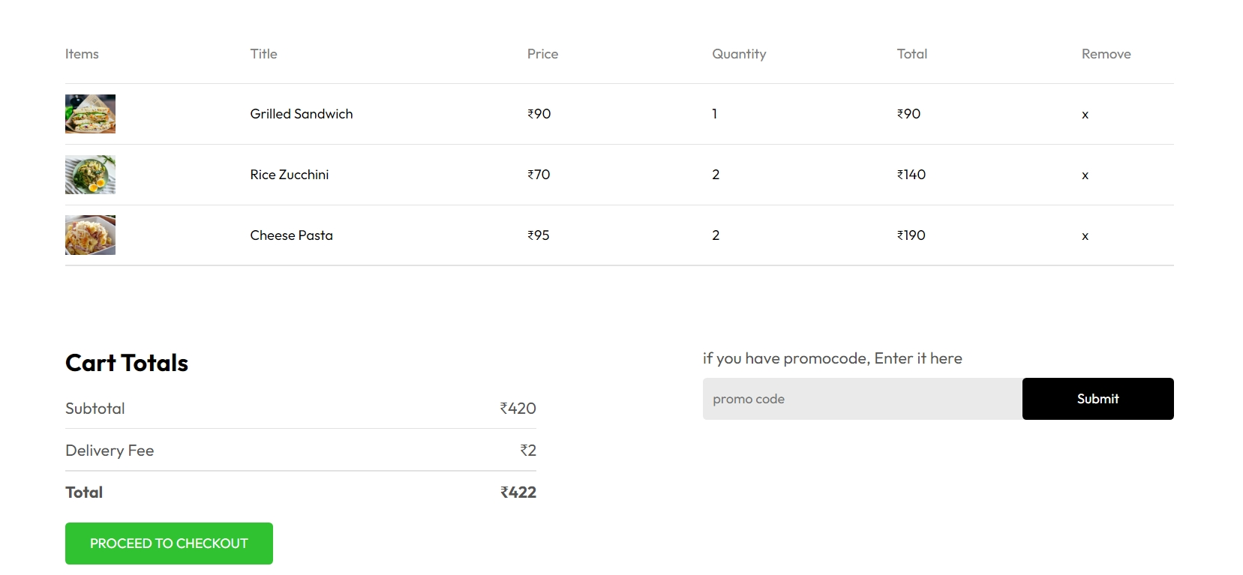
This is Cart page it have food items with price , totals ,quantity , remove icon and promocode . In each food item it have plus icon “+” by clicking that food item will added to cart page . Based on product and price the total amount was calculated.

Slide 10
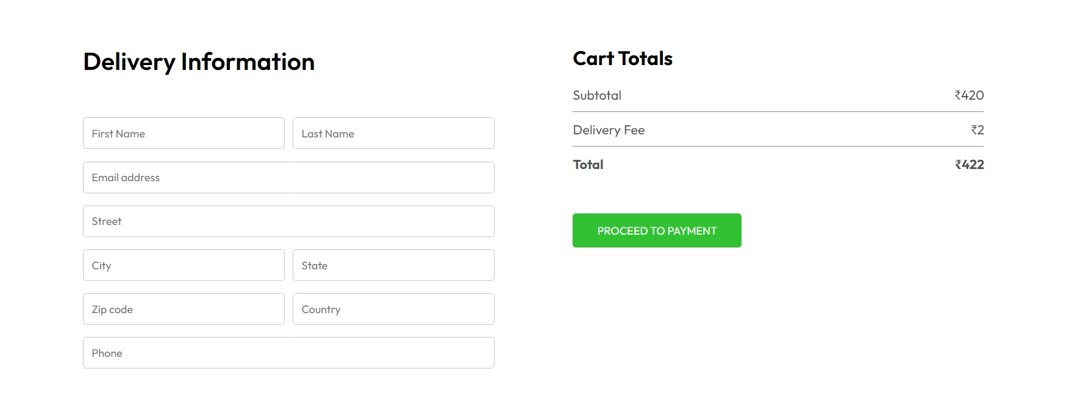
This Delivery information page it have cart total and delivery information,
In delivery information having some user inputs to deliver the food products to user address and Cart totals carryover from cart pages and atlast it procced to payment option.

Slide 11
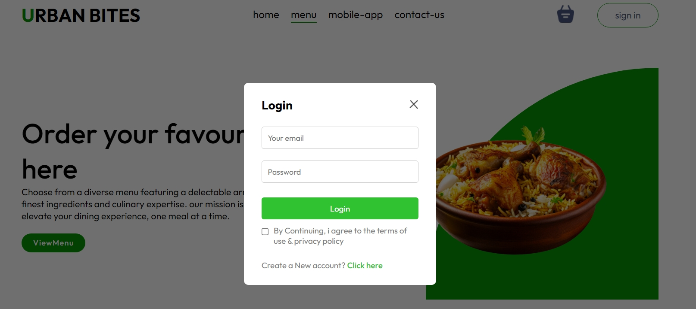
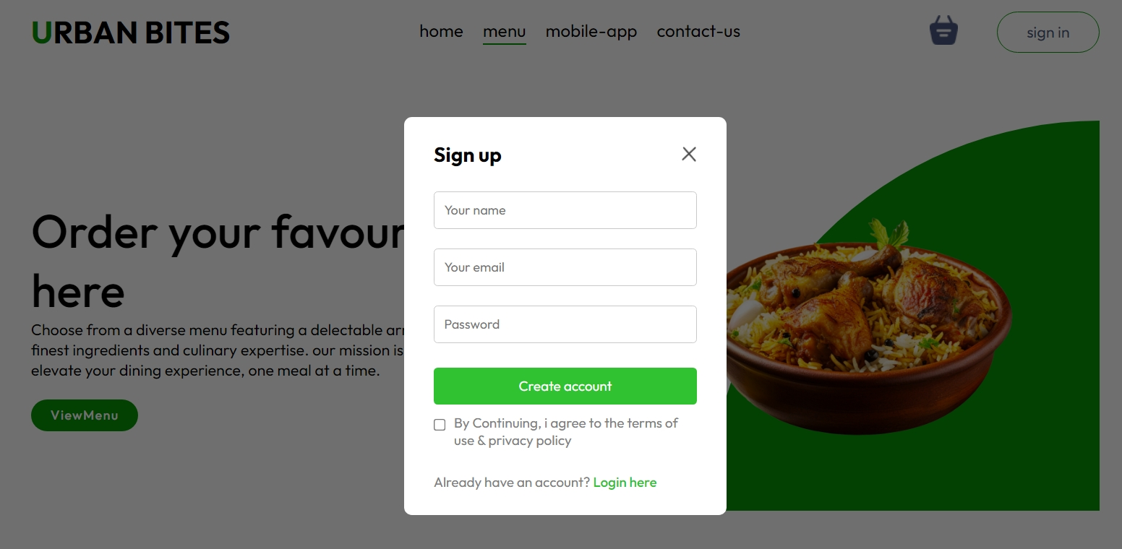
.
This is Sign up page it have email ,name and password . Cretated by using input tag and placeholder attribute . If you already have an account go to login page by clicking “login here” and then login page is appeared it contain email and password

Slide 12
Advantages : 1. Convenience: you can order food anytime from the comfort of your home. 2. Variety: access to many restaurants and cuisines in one place. 3. Time-saving: quick and easy ordering process saves time. 4. Reviews: user reviews help you choose the best dishes and restaurants. 5. Deals: many sites offer discounts and special deals. Disadvantages : 1. Delivery fees: extra costs for delivery services. 2. Waiting time: delivery might take longer than expected. 3. Errors: sometimes, orders can be incorrect or items might be missing. 4. Limited customization: not all special requests can be accommodated. 5. Service fees: additional charges for using the platform.

Slide 13
Conclusion
Our food delivery website offers a fast, easy, and convenient way to order meals online. It connects users with their favorite local restaurants, ensuring fresh and delicious food delivered to their doorstep. The user-friendly interface and reliable delivery service make it a top choice. Experience hassle-free meal ordering with our efficient platform.
.

Slide 14
Thank you
.

